Slide 1
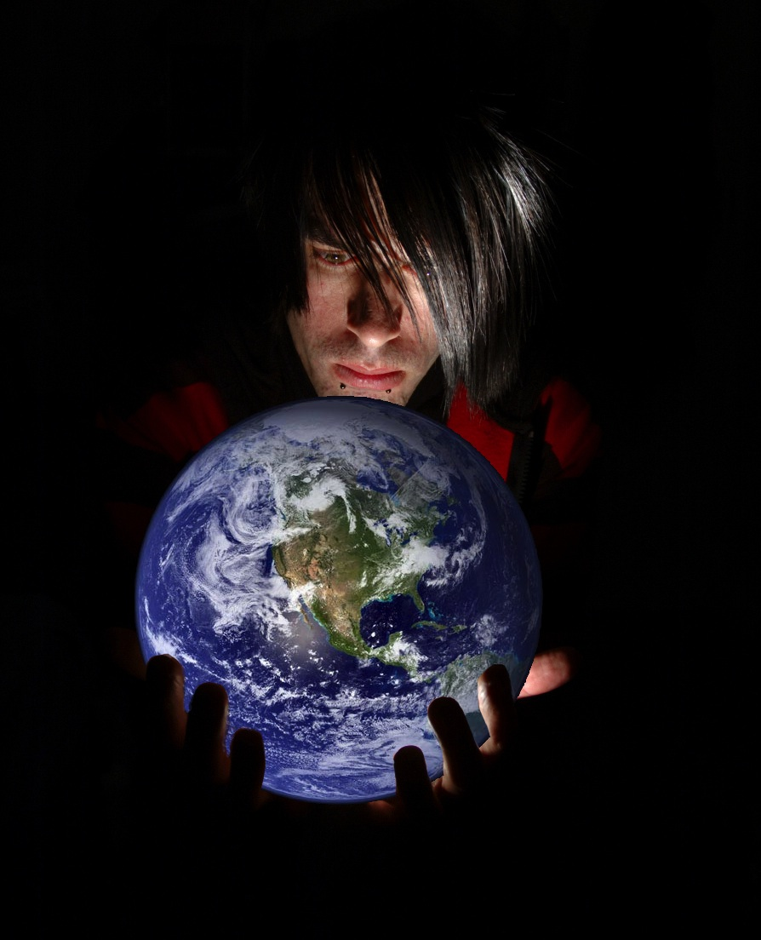
Web Architecture
http://www.flickr.com/photos/restlessglobetrotter

Slide 2
Aims (pm)
Building blocks of the web.
Layers, URLs and URIs
How do machines see the web?
Content negotiation and the web API / web of data

Slide 3
Question 1
What is the difference between the Web and the Internet?

Slide 4
The Internet
HTTP (Web), FTP, POP3, DNS
Application Layer
Application Layer
A Bus
Transport Layer
Like a road
3 main “physical” layers
Think of these like foundations
TCP, UDP
Transport (Packet) Layer
IPv4, IPv6
Protocol (Layer 3)
ADP, MAC
Link (Layer 2)
Cables and Wires
Physical (Layer 1)

Slide 5
Web Jargon
HTTP (Web), FTP, POP3, DNS
Application Layer
HTTP:
HTML:
DNS:
HyperText Transfer Protocol
HyperText Markup Language
Domain Name resolution System

Slide 6
Representation Layer
HTML, XML, CSV, RDF, TXT, ….
Representation Layer
HTTP (Web), FTP, POP3, DNS
Application Layer

Slide 7
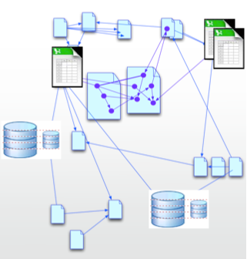
The Web Bit
Resources are identified using URIs, URLs and URNs
A Web is made via linking resources together

Slide 8
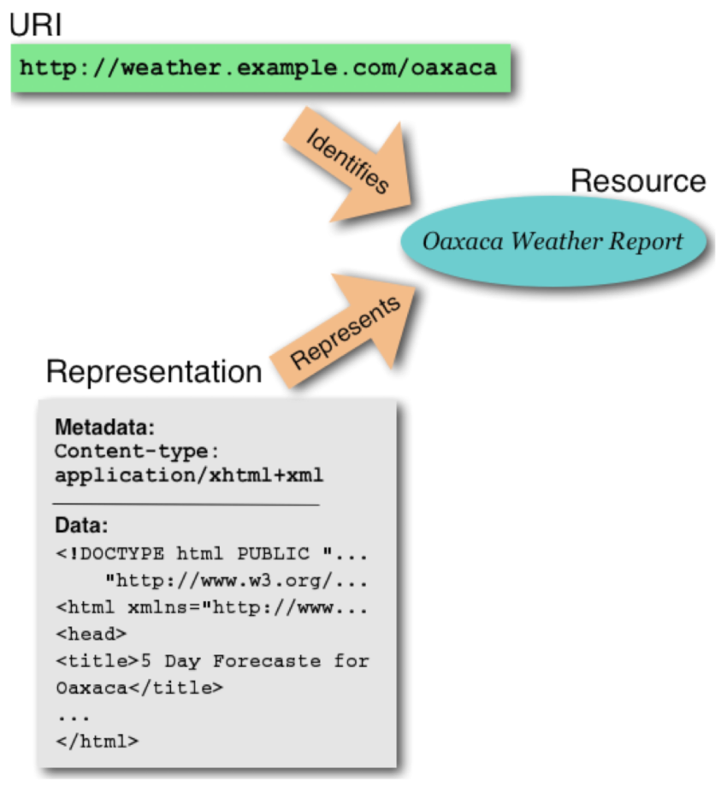

Resources

Slide 9
Identifiers refer to a resource in the application layer, not the representation layer.

Slide 10

UR What?
ISSN: 1744-988X
http://eprints.soton.ac.uk/id/eprint/341927
doi:10.1177/1744987112449969
http://eprints.soton.ac.uk/341927/
ISSN: 1361-4096

Slide 11
UR What?
ISSN: 1744-988X
These are all identifiers for the same thing.
This one thing might be available in many representations:
Book
eBook
PDF
HTML
Word Doc
http://eprints.soton.ac.uk/id/eprint/341927
doi:10.1177/1744987112449969
http://eprints.soton.ac.uk/341927/
ISSN: 1361-4096

Slide 12
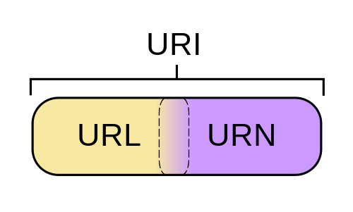

URN: …………..
Uniform Resource Name
Persistent
Location Independent
Identifier
http://en.wikipedia.org/wiki/File:URI_Euler_Diagram_no_lone_URIs.svg
http://www.ietf.org/rfc/rfc2141

Slide 13

http:// …………..
Uniform Resource Locator
Tells you how and where to find an instance of a resource
https://www.google.co.uk:80/search?q=what+is+an+issn#rcnt
http://www.ietf.org/rfc/rfc1738

Slide 14
http:// …………..
Uniform Resource Locator
https://www.google.co.uk:80/search?q=what+is+an+issn#rcnt
1
2
3
4
5
6
1: The Protocol (from the application layer)
2: The Address (think street address)
3: The Port (think flat number)
4: The Path (think item in flat)
5: Parameters (what to request of that item)
6: Fragment (what part of the returned content to look at)

Slide 15
http:// …………..
Uniform Resource Identifier
An Identifier for a Resource
Uses the URL syntax to aid in Identification
http://id.ecs.soton.ac.uk/person#7113
http://www.ietf.org/rfc/rfc3986

Slide 16
http:// …………..
Uniform Resource Identifier
http://id.ecs.soton.ac.uk/person#7113
1
2
3
4
1: The Protocol (this is a web based URI)
2: The Authority (think organisation)
3: The Path (think database table)
4: The Resource (think item)

Slide 17
UR What?
http://www.bbc.co.uk/music/artists/24f1766e-9635-4d58-a4d4-9413f9f98a4c
https://github.com/theodi/hot-drinks.git
urn:isbn:0451450523
mailto:davetaz@theodi.org
ftp://anonymous@files.cnet.com/software/JaSFtp/jasftp.msi
doi:10.3998/3336451.0004.203
http://id.ecs.soton.ac.uk/person/7113
http://dbpedia.org/resource/Open_Data_Institute
http://www.ecs.soton.ac.uk/people/timbl/index.html
http://en.wikipedia.org/wiki/Open_Data_Institute
file:///home/davetaz/Documents/ODI/Open_Data_In_Practise.pptz
urn:uuid:24f1766e-9635-4d58-a4d4-9413f9f98a4c
http://www.ecs.soton.ac.uk/people/timbl

Slide 18
Making a # of it!
http://id.ecs.soton.ac.uk/person#7113
How would I request the name of person #1733?

Slide 19

Don’t make a % of it
Internationalised Resource Identifier (IRI)
http://ヒキワリ.ナットウ.ニホン
http://%E3%83%92%E3%82%AD%E3%83%AF%E3%83%AA.%E3%83%8A%E3%83%83%E3%83%88%E3%82%A6.%E3%83%8B%E3%83%9B%E3%83%B3

Slide 20
HTTP
HTTP (Web), FTP, POP3, DNS
Application Layer
HyperText Transfer Protocol
more than just http://

Slide 21
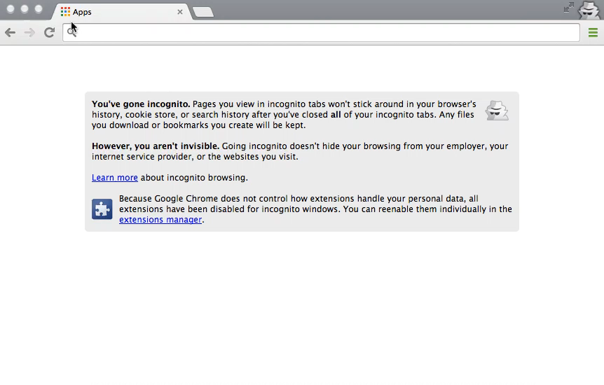
How we use the web

Slide 22
What decisions were taken for you?
Google.com redirected to google.co.uk
Searching google.co.uk assumed you wanted english
Clicking the link assumed you wanted the pretty html page representing Albert Einstein
So all of the application layer is hidden

Slide 23
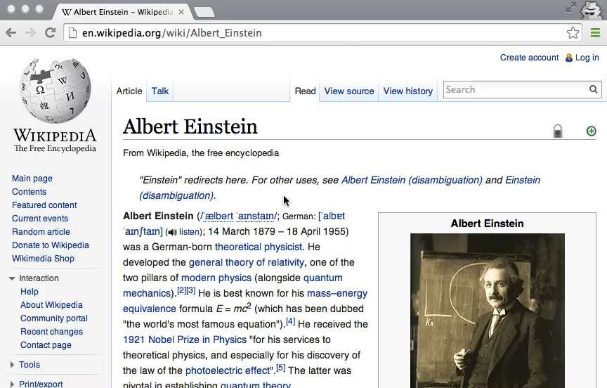
In Spanish?

Slide 24
So what did we need to do?
Search on the page and hope!

Slide 25

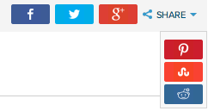
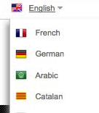

Common links
RSS Feed Social channels
Languages
Printable version

Slide 26
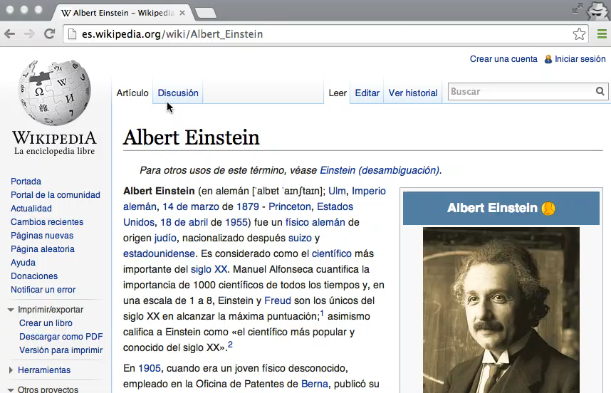
Printed version

Slide 27

Common links
RSS Feed Social channels
Languages
Printable version

Slide 28
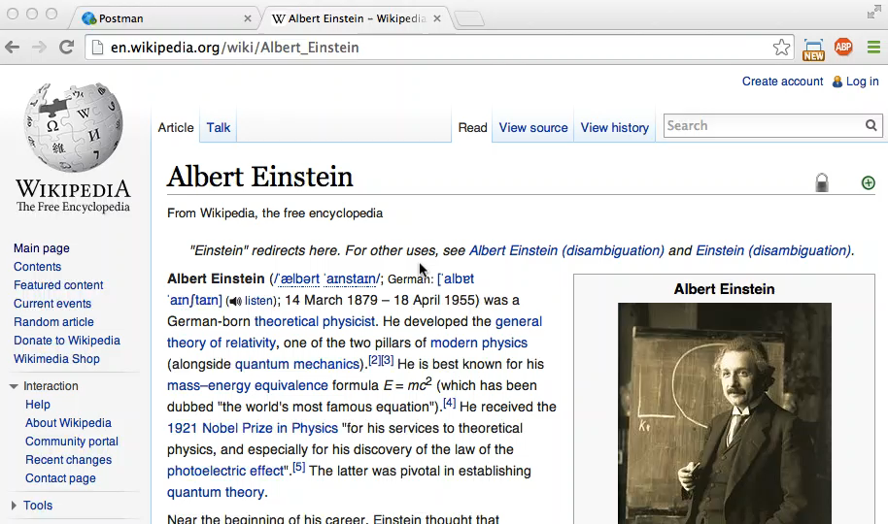
How a machine does it

Slide 29
A Web Request
GET / HTTP/1.1
http://en.wikipedia.org/wiki/Albert_Einstein
telnet en.wikipedia.org 80
> GET /wiki/Albert_Einstein HTTP/1.1
> Host: en.wikipedia.org

Slide 30
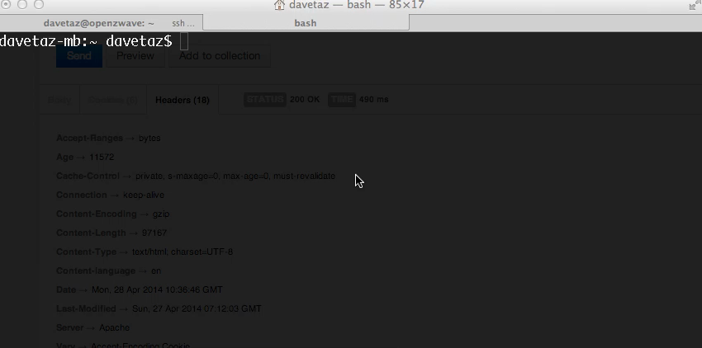
A Web Request

Slide 31
The same
=

Slide 32
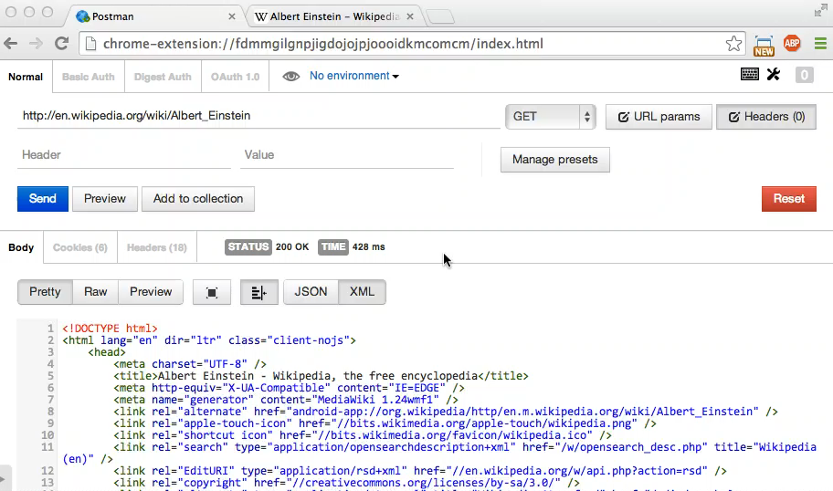
Headers
The headers define the properties of an HTTP transaction.

Slide 33


How a machine does it
I have an address (don’t care about it being a URI or URL)
I would like a different version:
Accept:
Accept-Language:
application/rss+xml
es-es

Slide 34
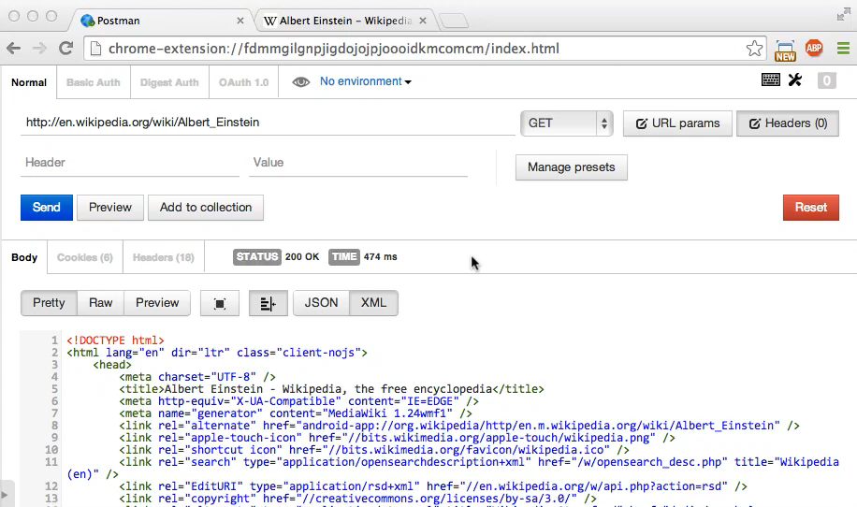
Spanish please

Slide 35
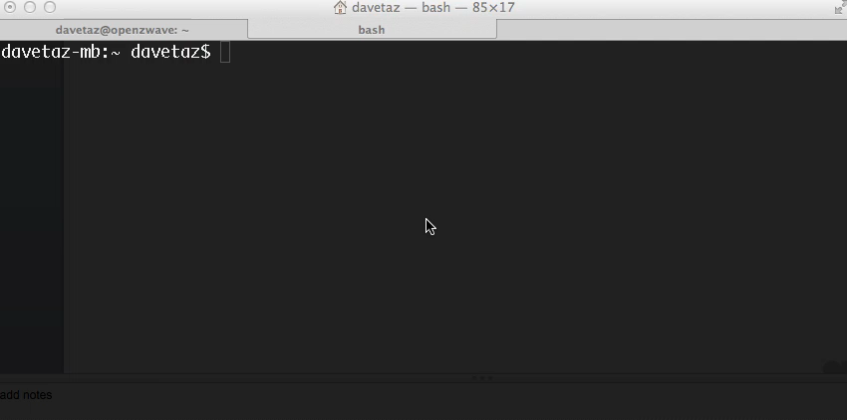
What happened?
!

Slide 36

Common links
RSS Feed Social channels
Languages
Printable version

Slide 37
Error Codes
100: Go
200: Got it
300: Not me
400: Your problem
500: Maybe it’s my problem

Slide 38
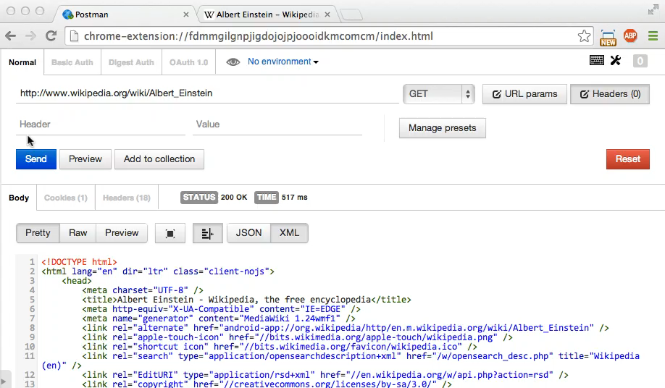
Try again
application/atom+xml

Slide 39
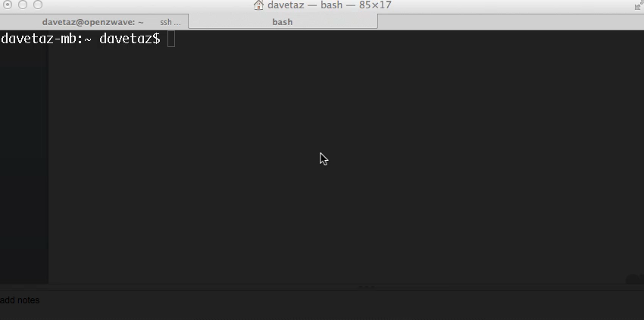
and again
application/atom+xml
!

Slide 40
Common links
RSS Feed Social channels
Languages
Printable version

Slide 41

So what do you have?

Slide 42
The <link rel=…> tag
So who and what is the <link rel=…> tag for:
To stop the number of HTTP headers forever expanding?
To add custom headers? (Even though that is what X-* headers are)
Should machines have to search all the possible link-rel headers related to a resource and other links. (recurse, recurse, recurse)

Slide 43
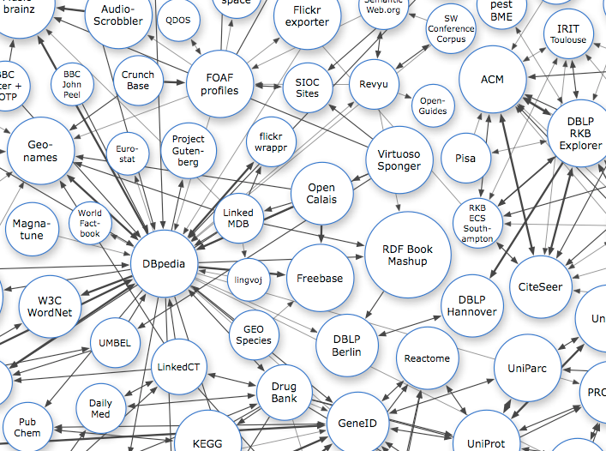

It’s not all doom and gloom
The data version of wikipedia, available in a machine friendly way.

Slide 44

Wikipedia & dbpedia
URIS
www.wikipedia.org/wiki/Albert_Einstein
http://dbpedia.org/resource/Albert_Einstein

Slide 45


de.wikipedia.org/wiki/Albert_Einstein
en.wikipedia.org/wiki/Albert_Einstein
es.wikipedia.org/wiki/Albert_Einstein
URIS
www.wikipedia.org/wiki/Albert_Einstein
http://dbpedia.org/resource/Albert_Einstein

Slide 46
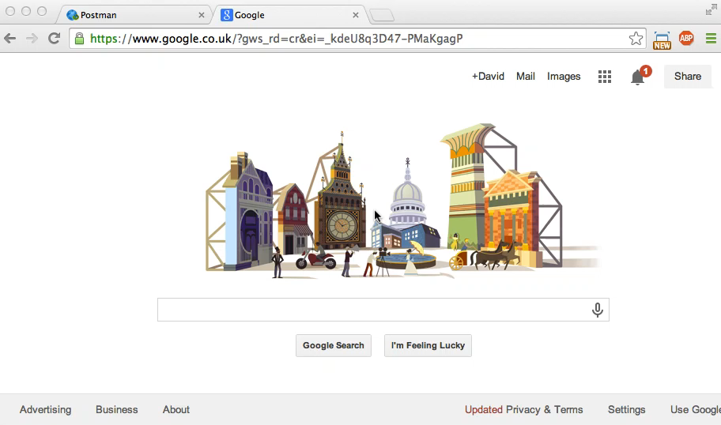

Slide 47
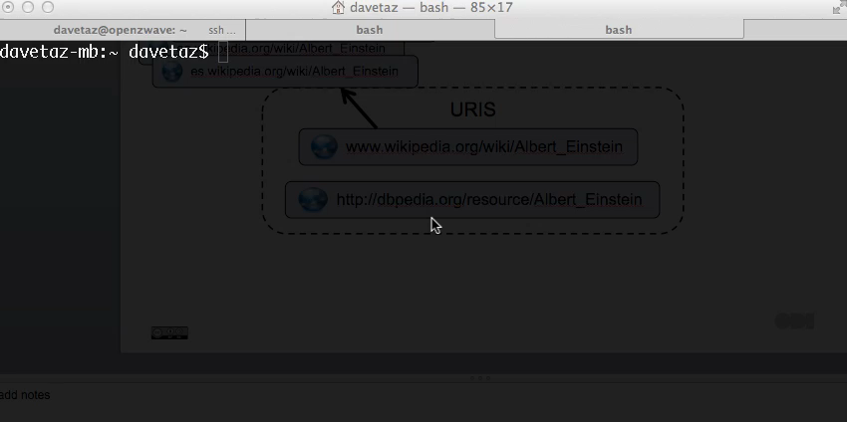

Slide 48

Common links
RSS Feed Social channels
Languages
Printable version

Slide 49

URL, URI, UR What!?!
Representation Layer
http://dbpedia.org/page/Albert_Einstein
http://dbpedia.org/data/Albert_Einstein.xml
http://dbpedia.org/data/Albert_Einstein.json
Application Layer / URI
http://dbpedia.org/resource/Albert_Einstein

Slide 50
303 hell
The HTTP 3XX codes redirect
Ask for a URI (application layer) and get redirected to the correct representation.
What should happen when you ask for a different version of a representation? 404? 406? 303?

Slide 51
HTTP Range-14
★★★★ - Use HTTP URIs to identify things and when people look up those URIs on the web, provide useful information and data.
Identifier for the person Albert Einstein.
You cannot download a person, even if they are alive.
http://dbpedia.org/resource/Albert_Einstein

Slide 52
Use 303
Representation Layer
http://dbpedia.org/page/Albert_Einstein
http://dbpedia.org/data/Albert_Einstein.xml
http://dbpedia.org/data/Albert_Einstein.json
Application Layer / URI
http://dbpedia.org/resource/Albert_Einstein

Slide 53

Which one is the URI?
http://dbpedia.org/page/Albert_Einstein
http://dbpedia.org/data/Albert_Einstein.xml
http://dbpedia.org/resource/Albert_Einstein
http://dbpedia.org/data/Albert_Einstein.json

Slide 54
Questions
Can the URL and URI ever be the same?
What if I do want an HTML representation of an HTML representation?
What if I do want to describe a mistake in the HTML representation?
Should we see browsers change URIs/URLs?

Slide 55
Questions
We need better semantics
This is a long-standing AI problem

Slide 56
Answers
Experts have been discussing HTTP-Range-14 problem since 2002!
https://www.w3.org/2001/tag/group/track/issues/14
The original discussion is now closed but continues in HTTP-Redirections-57
https://www.w3.org/2001/tag/group/track/issues/57
http://www.ibiblio.org/hhalpin/homepage/notes/uri.html

Slide 57
Current practices
URI
URLs
.html
.csv
.xml
.json
.rdf
http://www.bbc.co.uk/music/artists/d24fb461-dee8-41fc-bb15-2f13bb2644a6
The BBC use a URN based system to build URIs. Adding extensions gives you the URLs.
This way you can add an extension OR content negotiate

Slide 58
Current practice (2)
Representation Layer
http://dbpedia.org/page/Albert_Einstein
http://dbpedia.org/data/Albert_Einstein.xml
http://dbpedia.org/data/Albert_Einstein.json
Application Layer / URI
http://dbpedia.org/resource/Albert_Einstein

Slide 59
Recap

Slide 60
Representation Layer
HTML, XML, CSV, RDF, TXT, ….
Representation Layer
HTTP (Web), FTP, POP3, DNS
Application Layer

Slide 61
UR What?
ISSN: 1744-988X
http://eprints.soton.ac.uk/id/eprint/341927
doi:10.1177/1744987112449969
http://eprints.soton.ac.uk/341927/
ISSN: 1361-4096

Slide 62
HTTP Get
GET / HTTP/1.1
http://dbpedia.org/resource/Einstein
telnet dbpedia.org 80
> GET /resource/Einstein HTTP/1.1
> Host: dbpedia.org

Slide 63
Headers
Accept-*
Content-*
Accept: text/html
Accept-Charset: iso-8859-5
Accept-Encoding: compress, gzip
Accept-Language: da, en-gb; q=0.8, en;q=0.7
Accept-Ranges: bytes
Content-Type: text/html
Content-Encoding: compress, gzip
Content-Language: da
Content-Ranges: bytes
Content-Length:
Content-MD5:
Content-Location:
Cache-
Authorization

Slide 64
Content Negotiation
Content negotiation is the single most important aspect of the web of data
Content negotiation is used to request a specific representation of a resource from the representation layer using the application layer URI.
Often this process will return a HTTP 303 redirect to the URL of the representation you are requesting.

Slide 65

Example
http://dbpedia.org/resource/Einstein
telnet dbpedia.org 80
> GET /resource/Einstein HTTP/1.1
> Host: dbpedia.org
> Accept: application/json
HTTP/1.1 303 See Other
Date: Thu, 24 Apr 2014 09:49:02 GMT
Content-Type: application/json; qs=0.6
Location: http://dbpedia.org/data/Einstein.json

Slide 66
Common errors
Many web servers do not have content negotiation enabled.
Many web sites allow humans to access different representations of a resource by adding a file extenstion (.json, .csv, .xml) etc.
Machines don’t care about the URI OR extension, they use content negotiation.

Slide 67
The Future
(is in the past)

Slide 68

The power of headers
Accept:
Accept-Language:
Accept-Datetime:
application/rss+xml
es
Thu, 31 May 2007 20:35:00 GMT

Slide 69

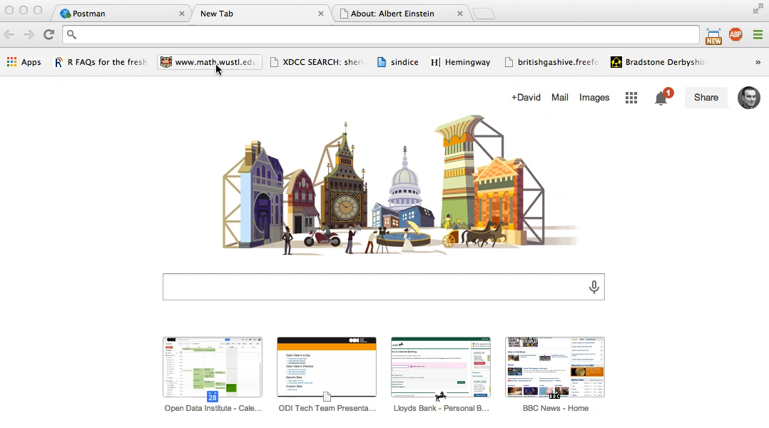
Demo
mementoweb.org

Slide 70
Why headers?
Say no to query parameters that control the representation. They are so very wrong!
www.wikipedia.org/wiki/Albert_Einstein?format=json&lang=en&timestamp=Thu%252C+31+May+2007+20%253A35%253A00+GMT
http://transportapi.com/v3/uk/public/journey/from/postcode:EC2A+4JE/to/stop:Canary+wharf/at/2013-10-18/15:29.json?not_modes=train

Slide 71
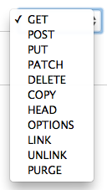
Web APIs
more than just GET

Slide 72
Taking a REST
APIs are machine to machine interfaces
The Web has an API you can build on, it’s called HTTP.
If you build an HTTP like API, or use HTTP as part of your API you may have built a RESTful API.

Slide 73
Verbs
GET
Asks for a representation of a specified resource
ONLY for retrieve!

Slide 74
Identifiers refer to a resource in the application layer, not the representation layer.
Qualify your GET (think shopping)

Slide 75
Verbs
HEAD
Identical to GET but don’t send the content (payload), just the headers.

Slide 76
More Verbs
POST
Do something with the content I give you
What you do depends on the service, mostly

Slide 77
More Verbs
PUT
Create a new resource at my defined URI location
Do it or fail

Slide 78
More Verbs
DELETE
Delete the resource at the URI specified
Do it or fail

Slide 79
Lesser supported
OPTIONS
Tell me the HTTP methods supported on this URI

Slide 80
Lesser supported
PATCH
Partially modify a resource between the given boundaries

Slide 81
Lesser supported
TRACE
echo back the request so I can see if there are any changes made in the middle

Slide 82
Safe methods
Safe methods
Destructive methods
GET
HEAD
OPTIONS
TRACE
PUT
POST
DELETE
PATCH

Slide 83
REST and CRUD
REpresentational State Transfer is the generic method by which resources can be exchanged between two agents.
Create Retrieve Update Delete is explicitly about API capability and sounds better than PGPPD (Put, Get, Post/Patch, Delete)

Slide 84
Error Codes
Q: Can I do this? (POST/PUT)
A: Yes (1XX) or No (4XX)
Q: OK do it! (POST/PUT)
A: Done (2XX) or Error (4XX,5XX)

Slide 85
Error Codes
Q: Get a resource!
A: It’s over there (3XX)
Q: OK, get that then
A: Sure (200)

Slide 86
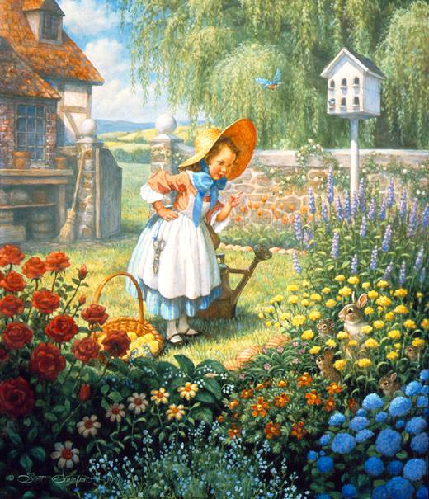
Nursery Rhymes
Mary, Mary, quite contrary,
How does your garden grow?
With silver bells and cockle shells
And pretty maids all in a row

Slide 87
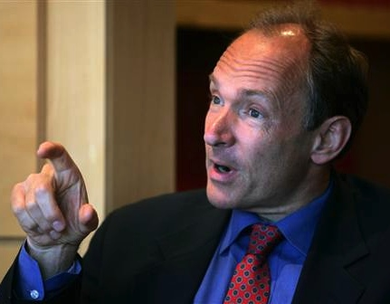
Nursery Rhymes
TimBL, TimBL, very nimble,
How does your data web grow?
With URLs and HTMLs
And GET and POSTs all in a row

Slide 88
Socrata
WARNING: Finding the URI for a dataset is not easy
Content-Types:
application/json
text/csv
application/rdf+xml
application/vnd.ms-excel
Search google for the mime types of formats in the export option.

